Slide 1



UNIT 4;
Earth Matters
Breaking news

Slide 2
Translate
topic
to cover
an article
to rescue
earthquake
a guide
a rescue dog
to seek out
a victim
trapped
a search team
an international
licence
a lead
quotation
headline
summary
paragraphs
facts
to publish
to skim
međunarodna
dozvola
uvod
citat
naslov
sažetak
odlomak
činjenice
objaviti
brzinski proći kroz tekst
tema
izvijestiti o nečem, pokriti
članak
spasiti
potres
vodič
spasilački pas
tražiti
žrtva
zatočen
tim za potragu

Slide 3
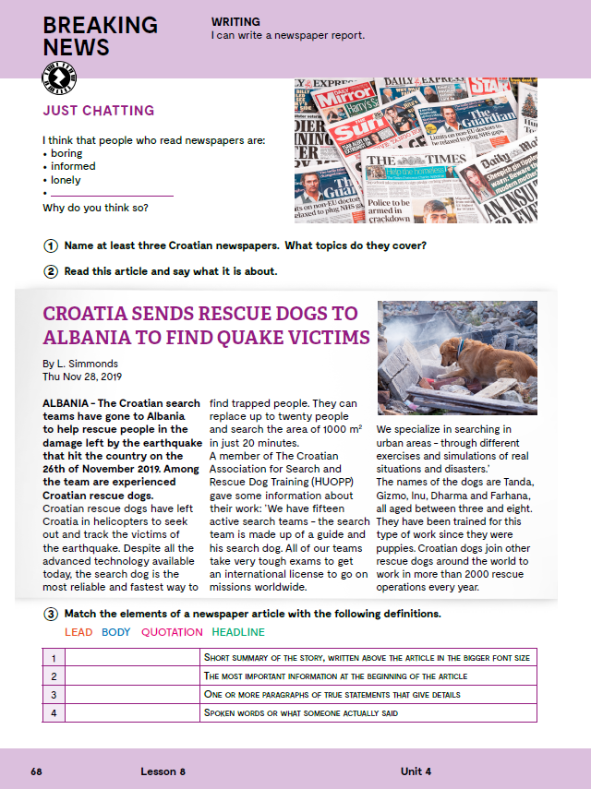
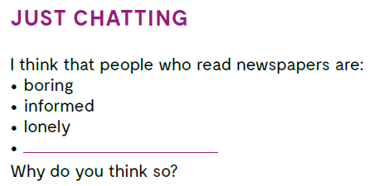
Think! What kind of people read newspapers?

Slide 4
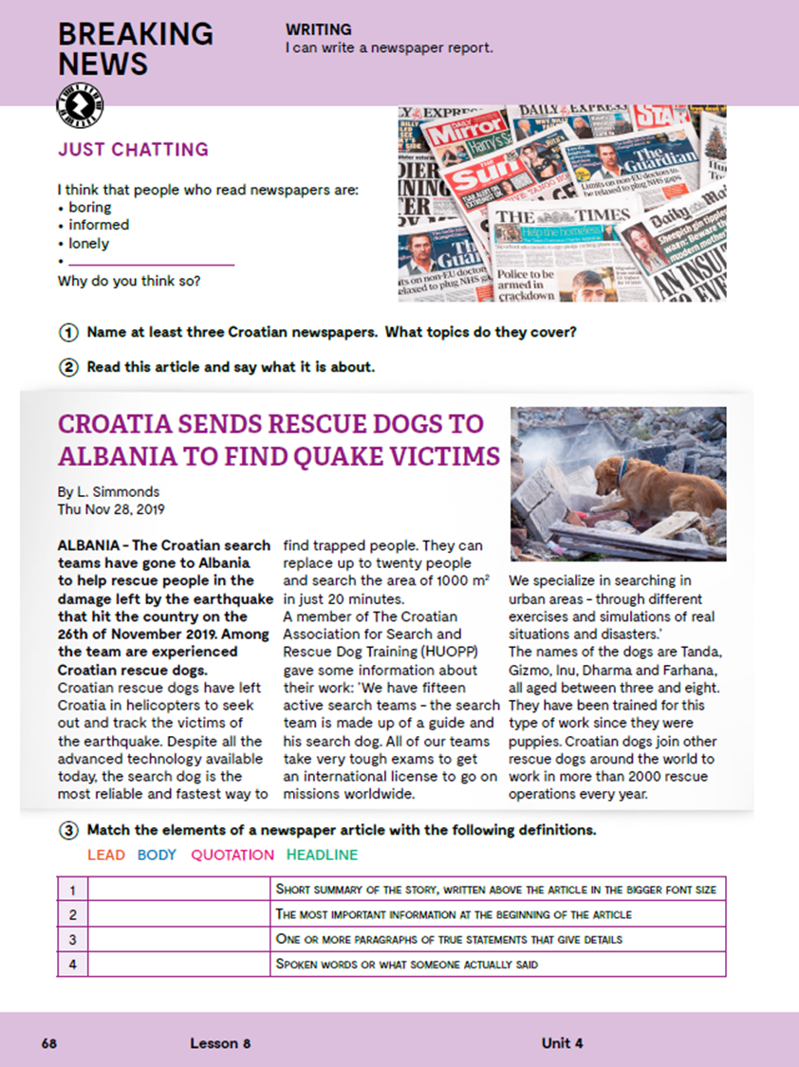
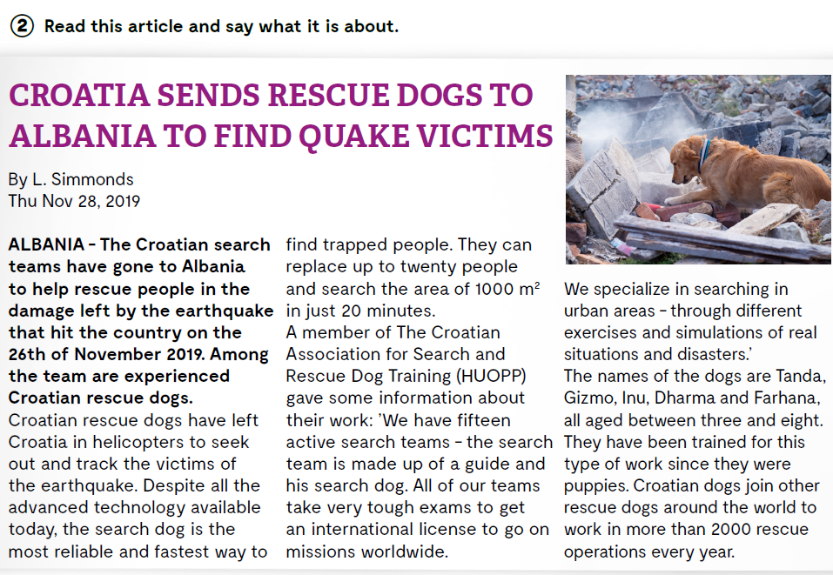

Slide 5
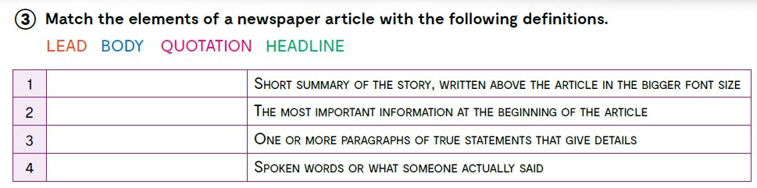
LEAD
HEADLINE
BODY
QUOTATION

Slide 6
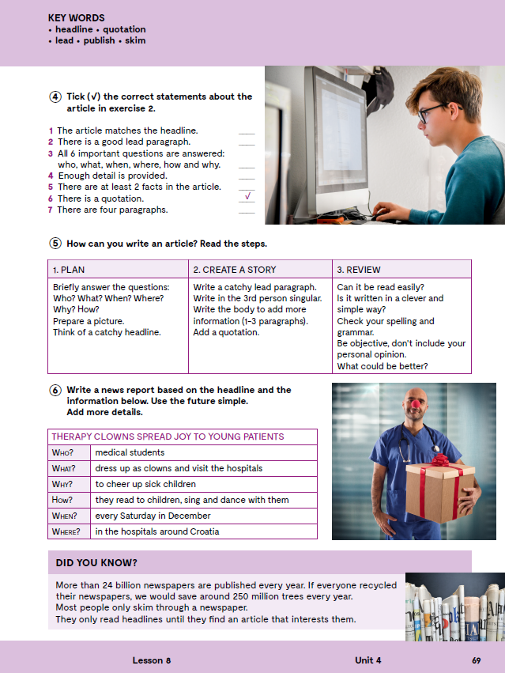
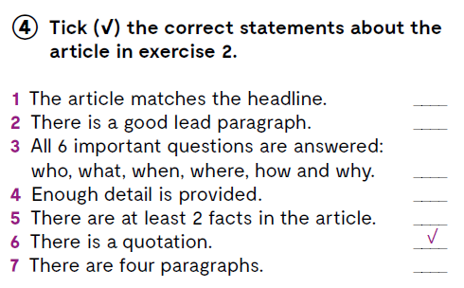

Let’s practise:
https://wordwall.net/play/846/151/890

Slide 7

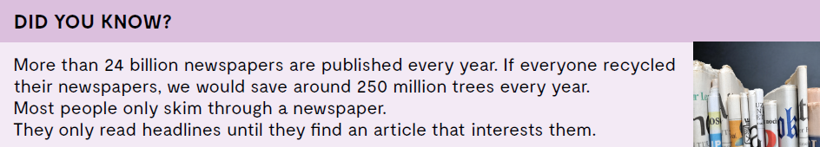

What is a lead?
What is a body?
What is a quotation?
What is a headline?
LEARN MORE!
https://www.e-sfera.hr/dodatni-digitalni-sadrzaji/e8796efe-9803-4bb7-ba16-fccc83ab9fad/
10 steps to writing a news story

Slide 8
